Slide 1
DISTRICT ADMINISTRATION
Chennai Lucknow
BY
SOURABH SHARMA
(RA2111042010007)

Slide 2
CONTENT
What is District Administration?
FUNCTIONS OF DISTRICT ADMINISTRATION
Deputy Commissioner
District Administration – LUCKNOW
District Administration – CHENNAI
SUMMARY

Slide 3
What is District Administration?
District Administration means the management of the task of government so far as it lies within an area legally recognized as a district. According to Khera, “District administration is the total management of public affairs within this unit.” The district is kept under the charge of a district officer—called either Deputy Commissioner or District Collector who acts as the eyes, ears and arms of the State Government. As such D.C.’s task is of pivotal nature. This task is of five kinds viz., Revenue, Magisterial, Judicial, Executive and Development.

Slide 4
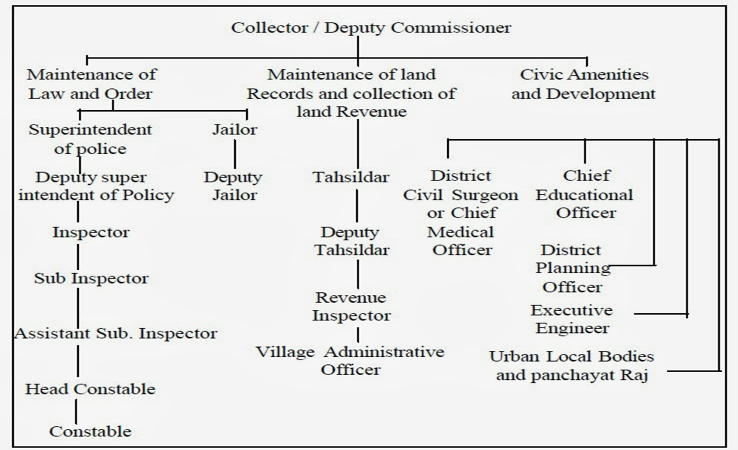

Slide 5
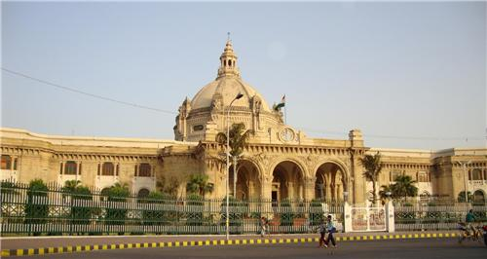
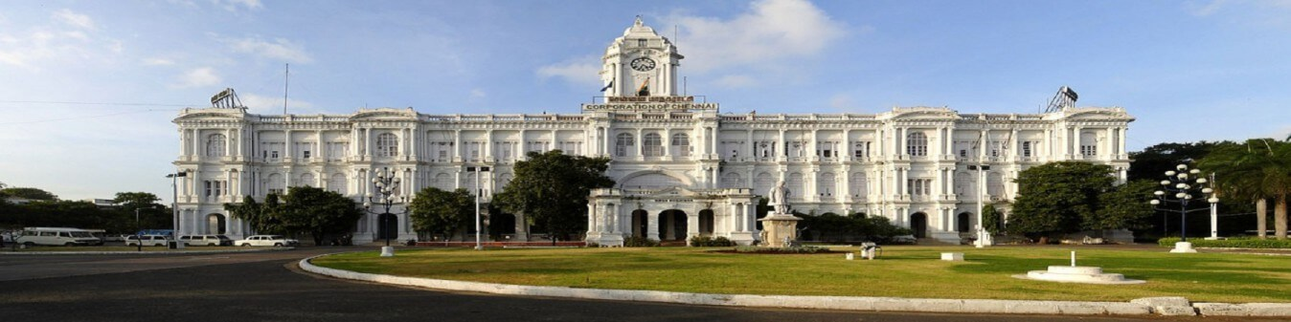
Administration office lucknow administration office chennai

Slide 6
FUNCTIONS OF DISTRICT ADMINISTRATION
1. Law and order and magisterial matters: The first group of functions relates to public safety and tranquility. Maintenance of Law and order is the joint responsibility of the Superintendent of Police, who head the Police force in the district, and the District Magistrate. The Deputy Commissioner of the District is also the District Magistrate. Though there is a separate department for the administration of jails, the district Magistrate exercises general supervision over the Jails in his district.
2. Land Revenue : The second group of functions relates to revenue administration. While the most important component of this group is land administration including maintenance of land records, it also includes the assessment and collection of land revenue and also collection of the other public dues which are collected as arrears of land revenue. The Deputy Commissioner is a designated Revenue officer in various laws governing the land to deal with disputes arising out of land records and management of public lands and properties. The other revenue officers, namely, the Assistant Commissioners, the Tahsildars and the Deputy Tahsildars also perform functions of dealing with land disputes under the overall supervision and control of the Deputy Commissioner.

Slide 7
FUNCTIONS OF DISTRICT ADMINISTRATION
3. Development Activities: These include Public Health, Education, Social Welfare, welfare of Backward Classes and communities. Each of these functions is looked after by separate department, headed by a specialist officers in the district. The various special economic programs like Jawahar Grama Samrudhi Yojana (JGSY), Swarnajayanthi Grama Swarozgar Yojana, etc. and the poor people's housing scheme Ashraya are implemented by the Zilla Panchayats in each district. The Deputy Commissioner does not get a direct role in these schemes. However, since these programs call for an integrated effort by various field departments at the district level, Public Works Department and Minor Irrigation, Forest etc., the role of D.C. in co-coordinating and guiding their activities is of prime importance for successful implementation of these programs. Social Security measures like Old age Pension, Widows Pension, Maternity allowance to expectant mothers and stipends to physically Handicapped persons, Workmen’s compensations matters, rehabilitation of displaced persons under various projects Aids for Religious (Muzrai Schemes) and charitable Institutions and Endowments are also carried out.
4. Regulatory Functions: These include
(i) control, regulation and distribution of Food and Civil supplies and essential commodities.
(ii) Excise and Prohibition matters.
(iii) All matters relating to Stamps and Registration, Societies registration Act, 1960, Registration of firms under the Indian Partnership Act, 1932.
(iv) Matters relating to Urban land (ceiling and regulation), vacant lands in urban areas(prohibition of alienation Act, 1975.
(v) Land Improvement Loans Act,1963, Agriculturists Loans Act, 1963., Non-agricultural Loans Act, 1958.

Slide 8
5. Elections and Citizenship Matters: This relates to holding of elections of Parliament, State Legislature and Local Bodies. The Deputy Commissioner is responsible for the proper observance of process of elections from the registration of voters to the declaration of results of elections. 6. Municipal Administration Matters : The DC is generally responsible for the supervision and proper functioning of the urban local bodies. The implementation of various developmental and anti-poverty measures for the urban poor is monitored by the Deputy Commissioner. The most important of these programs are the Swarnajayanthi Shahari Rozgar Yojana (SJSRY), Urban Ashraya (Housing), Tenth Finance Commission development grants and the Integrated Small and Medium Towns Development (IDSMT) Programs. 7. Emergency Relief : In situations like floods, famines, accidental fires, earthquakes and other natural calamities, the entire district administration is geared to meet the threat and the DC assumes charge to co-ordinate the activities of the various departments and takes proper steps to alleviate sufferings of the people. 8. Land Acquisition matters and Land Reforms: Acquisition of land for public purposes like construction of development projects, industries etc. is carried out by the Land Acquisition Officers under the control of the Deputy Commissioner. 9. Residuary functions: There are a number of executive functions of Government which have not been precisely defined and there is no separate representative of the Government to carry out such duties in the district. It is the DC, in his capacity as the chief representative of Government in the district, who has to deal with all residuary matters. This group of activities includes miscellaneous functions like collections under the small savings schemes, contributions to public loans, implementation of family planning programme etc.. 10. Public Grievances: The DC is the District Public Grievances officer, in consequence of which he maintains the overall responsibility to ensure proper functioning of all departments in the district. 11. Census 12. Regional Transport Authority 13. Visits of V.I.P.s 14. Treasuries 15. Budget estimates 16. Matters relating to forest
.

Slide 9
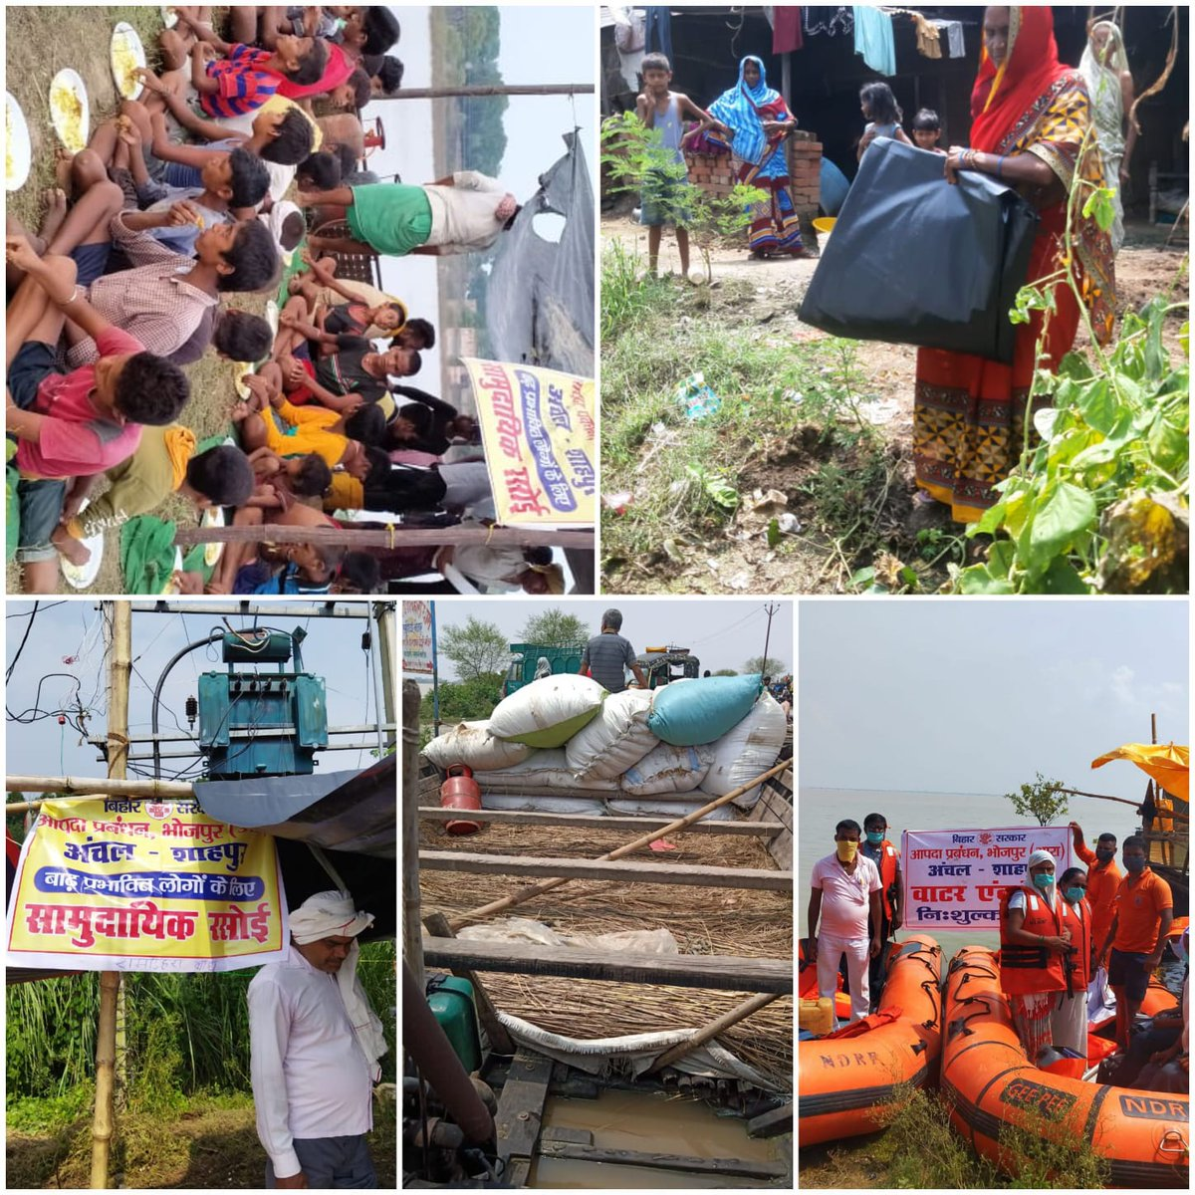
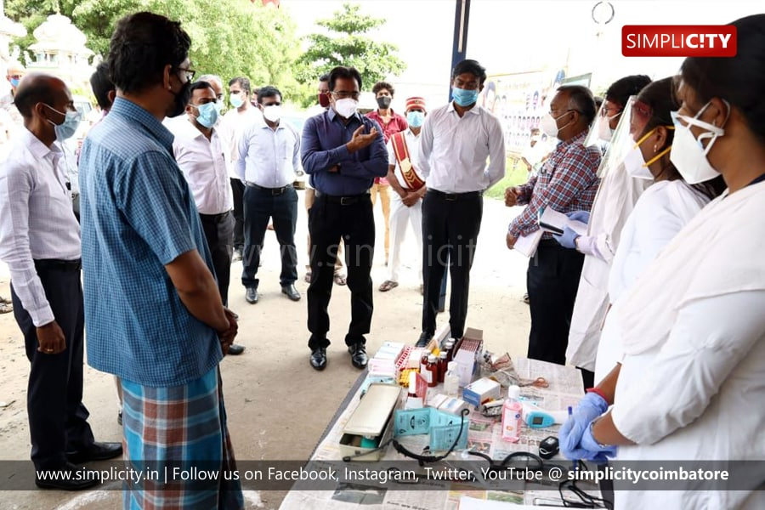
District administration
Administration helping during flood Administration helping during covid

Slide 10
Deputy Commissioner
The general administration of the district is vested with the Deputy Commissioner, who for administrative purposes, is under the Divisional Commissioner, Hisar. He is at once the Deputy Commissioner, the District Magistrate and the Collector. As Deputy Commissioner, he is the executive head of the district with multifarious responsibilities relating to development, panchayats, local bodies, civil administration, etc. As District Magistrate, he is responsible for law and order and heads the police and prosecuting agency. As Collector, he is the chief Officer of the revenue administration and is responsible for the collection of land revenue, and is also the highest revenue judicial authority in the district. He acts as the district Elections Officer and the Registrar for registration work. He exercises over-all supervision on other government agencies in his district. He is, in short, the head of the district administration, a coordinating officer among various departments and a connecting link between the public and the government so far as he executes the policies, administers the rules and regulations framed by the government from time to time .
The main functions of the Deputy Commissioner may be broadly categorised as co-ordination of development and public welfare activities as Deputy Commissioner, revenue officer/Court of the district as District Collector, and law and order functions as District Magistrate. Thus, he acts as Deputy Commissioner, District Collector and District Magistrate on different occasions. His role in each of these capacities is described, in brief, as under

Slide 11
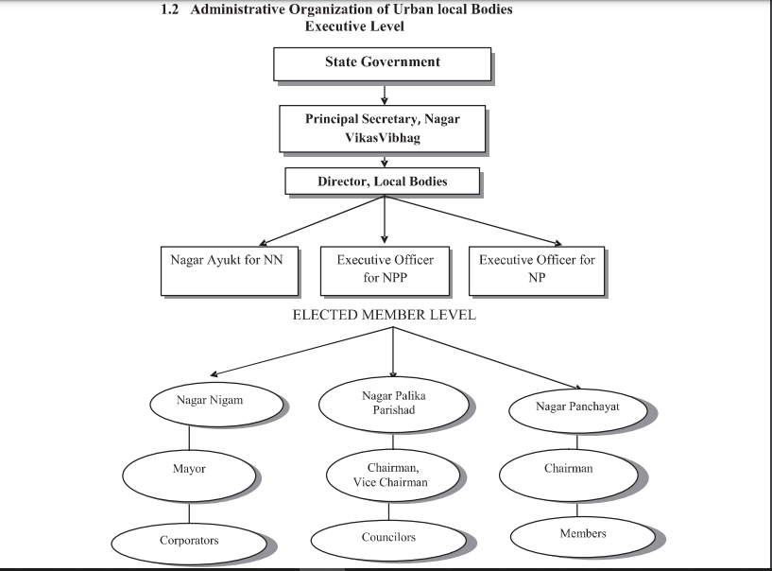
UTTAR PRADESH GOVERNING STRUCTURE

Slide 12
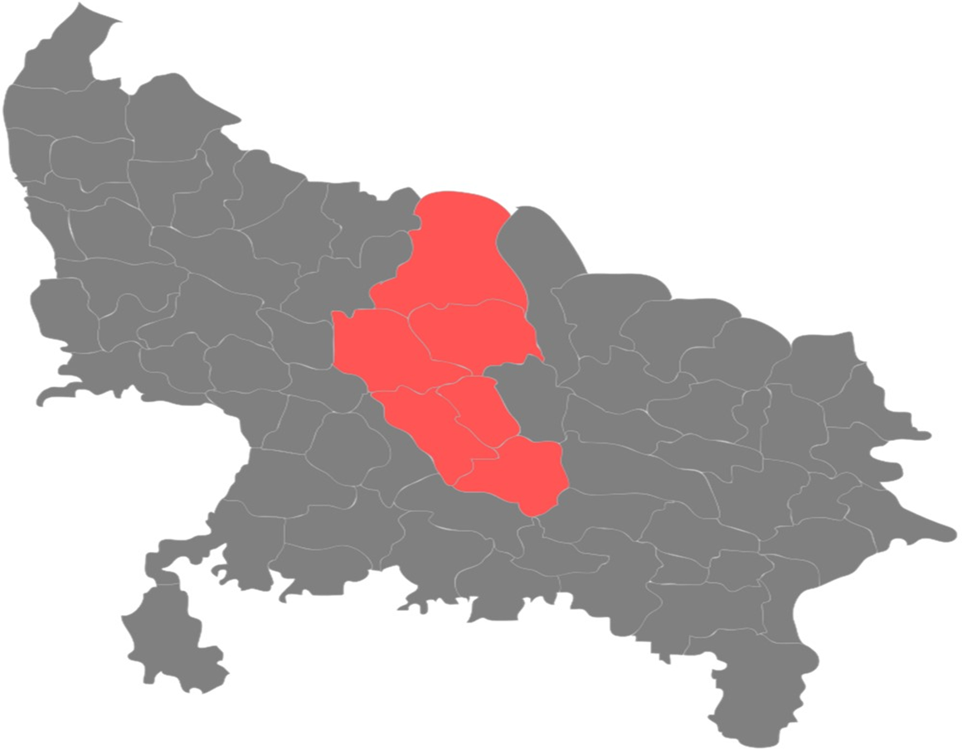
LUCKNOW DISTRICT
ABOUT LUCKNOW DISTRICT
Lucknow is the capital city of Uttar Pradesh and it has always been a multicultural city. Courtly manners, beautiful gardens, poetry, music, and fine cuisine patronized by the Persian-loving Shia Nawabs of the city are well known amongst Indians and students of South Asian culture and history. Lucknow is popularly known as the “The City of Nawabs”. It is also known as the “Golden City of the East”, “Shiraz-e-Hind” and “The Constantinople of India”.
AT A GLANCE
Area : 2528 sq.km
Language : Hindi , Urdu
Villages : 961
Population : 45,89,838
Male : 23,94,476
Female : 21,95,362
Police Stations : 43

Slide 13
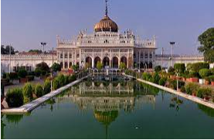
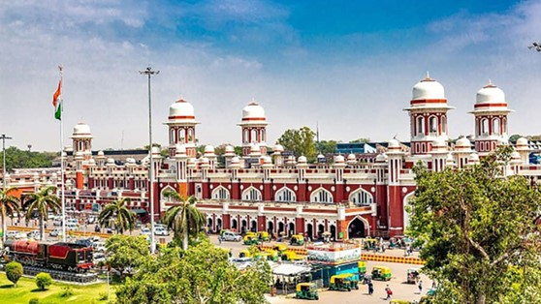
LUCKNOW ADMINISTRATION - Comissioner
LUCKNOW DIVISION :
Consists of Six Divisions - Lucknow, Hardoi, Lakhimpur Kheri, Raebareli, Sitapur, and Unnao
Headed by Divisional Commissioner of Lucknow, a senior IAS Officer
Head of Local government institutions including Municipal Corporations
Responsible for infrastructure development in the Lucknow district
In charge of maintaining the Law and Order in the area.
District Magistrate reports to the Divisional Commissioner of Lucknow
Current commissioner is Mukesh Meshram

Slide 14
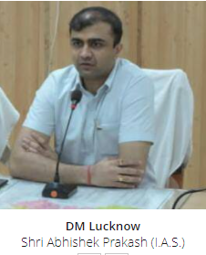
LUCKNOW ADMINISTRATION – District Magistrate
DISTRICT MAGISTRATE :
Lucknow district administration is headed by the District Magistrate of Lucknow, who is an IAS officer.
Overall looks after 5 Tehsils in the District each headed by an SDM
DM is supported by 1 CDO, 8 ADM, 1 Chief Magistrate and 7 ACM
In charge of property records and revenue collection for Central Govt.
Oversees the elections held in the district.
Current DM is Abhishek Prakash

Slide 15
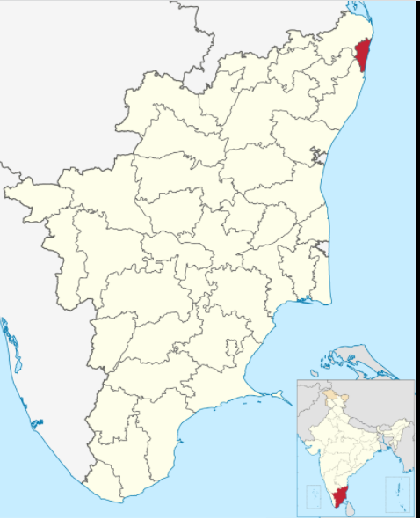
CHENNAI DISTRICT
ABOUT CHENNAI DISTRICT
Chennai district, formerly known as Madras district,[a] is one of the 38 districts in the state of Tamil Nadu, India. It is the smallest and the most densely populated district in the state. The district is coterminous with the city of Chennai, which is administered by the Greater Chennai Corporation. It is surrounded by Tiruvallur district in the north and the west, Kanchipuram district in the south-west, Chenglpattu district in the south, and the Bay of Bengal in the east.
AT A GLANCE
Area : 426 sq.km
Language : Tamil, English, Hindi
Villages : 122
Population : 46,46,732
Male : 23,35,834
Female : 23,10,888
Police Stations : 104

Slide 16
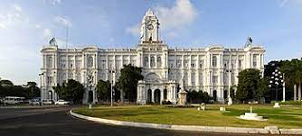
ADMINISTRATION OF CHENNAI
The Ripon Building, commissioned in 1913, houses the Chennai Corporation.
Chennai city is governed by the Chennai Corporation (formerly ―Corporation of Madras‖), which was established in 1688. It is the oldest municipal corporation in India and the second oldest corporation in the world.

Slide 17
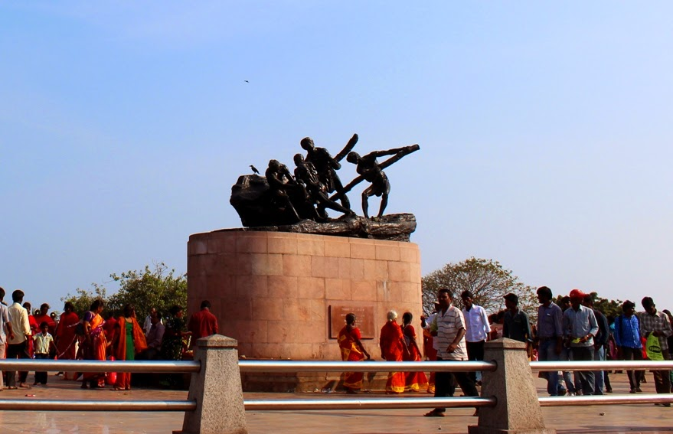
In 2011, the jurisdiction of the Chennai Corporation was expanded from 174 km2 (67 sq mi) to an area of 426 km2 (164 sq mi), dividing into three regions — North, South and Central, which covers 200 wards. The corporation is headed by an Indian Administrative Service officer. The Mayor and councillors of the city are elected through a popular vote by the residents. While the city limit was expanded to 426 km2 in 2011, the revised population is yet to be officially announced.
Chennai has three parliamentary constituencies—Chennai North, Chennai Central and Chennai South—and elects 14 Members of the Legislative Assembly (MLAs) to the state legislature.

Slide 18
District Administration - District Collectorate
The Collectorate play a pivotal role in the District administration. Collector in the Cadre of I.A.S heads the District. He/She acts as the District Magistrate for maintaining Law and Order in his/her jurisdiction. He/She deals mainly with Social Security Schemes, Land Matters and arms licensing etc.The Additional Collector/ District Revenue Officer runs the Revenue administration under various enactments in the District. He/She is also designated as Additional District Magistrate. He mainly deals with civil supplies, land matters, mines and minerals, village officers etc.
The District Revenue Officer (DRO) and Deputy Collectors assists the Collector in discharging their duties. The District Revenue Officer looks after all the branches of the Collectorate. The DRO deals mainly with general administration and is vested with supervision of day-to-day functions of the Collectorate.

Slide 19
Parliament Constituencies (3)
Chennai – Central
Chennai – North
Chennai – South
Assembly Constituencies (16)
1. Dr. Radhakrishnan Nagar 9. Chepauk-Thiruvallikeni
2. Perambur 10. Thousand Lights
3. Kolathur 11. Anna Nagar
4. Villivakkam 12. Virugampakkam
5. Thiru.Vi.Ka.Nagar 13. Saidapet
6. Egmore (SC) 14. Thiyagarayanagar
7. Royapuram 15. Mylapore
8. Harbour 16. Velachery

Slide 20
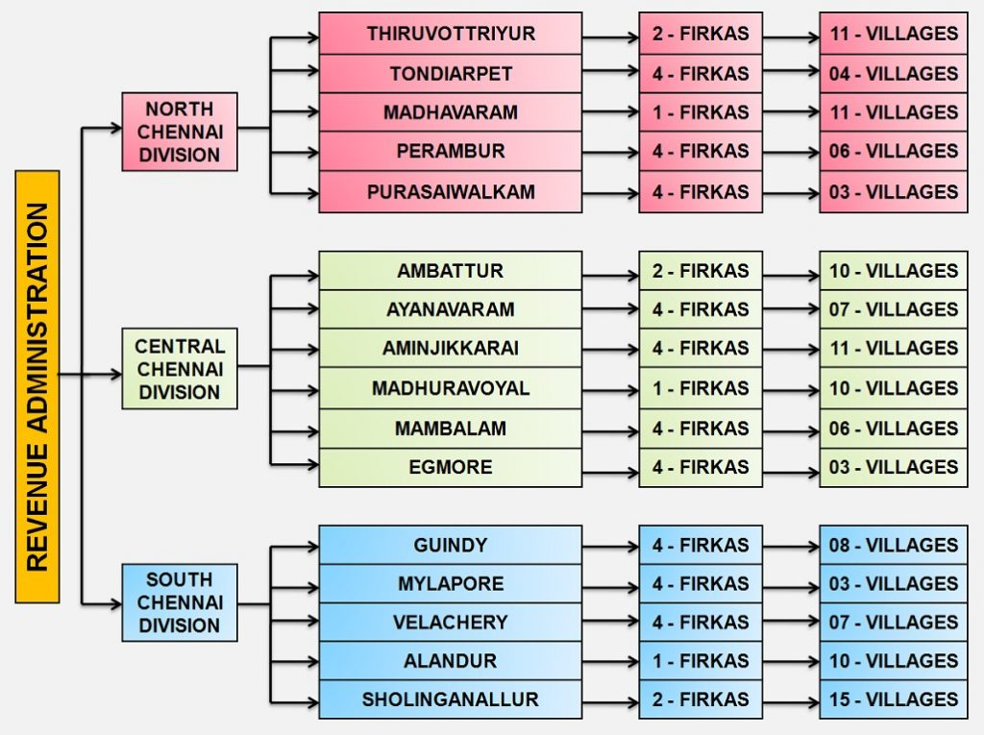

Slide 21
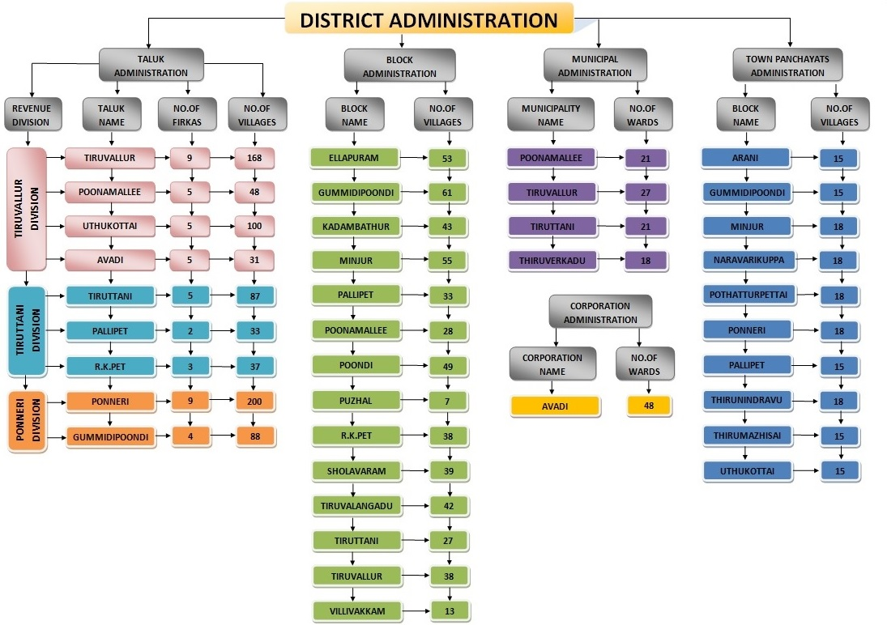

Slide 22
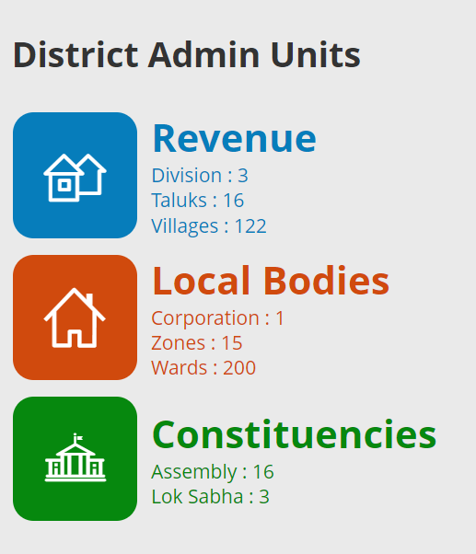
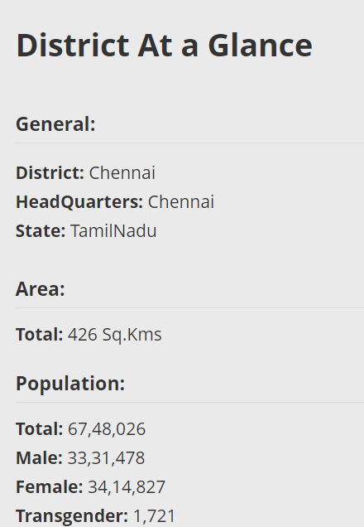

Slide 23
summary
For administrative convenience India is divided into states and the states further divided into districts. The district administration is responsible for maintaining law and order in the district. The district administrator is collector or the district magistrate. There are other officers to assist the Collector in the task of district administration. The Collector is the senior-most officer and looks after the administration of all the villages comes under the district

Slide 24
Thank You

